Slide 1
Design and Control of Autonomous Underwater Vehicle using Vision Based Feedback
Vishal Narayan Deka
234156031
M. Tech in Robotics and AI
Indian Institute of Technology Guwahati

Slide 2
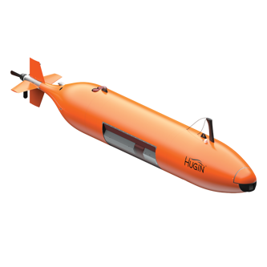
Autonomous Underwater Vehicles – Introduction
Unmanned, submersible vehicle requiring no real time input
Different from Remotely Operated Vehicles (ROVs)
Applications:
Inspection and Survey
Monitoring coastal areas
Mapping sea-bed
Goal: A low cost solution for an AUV with vision based feedback
Figure 1: The Hugin AUV
Source: https://www.kongsberg.com/discovery/autonomous-and-uncrewed-solutions/auv/hugin/
Notes:
Autonomous Underwater Vehicles or AUVs for short are essentially unmanned submersible vehicles that can work without real time input. Unlike the more prevalant and popular ROVs, AUVs are untethered to the surface and can potentially access harder to reach areas than ROVs. Lack of a tether also allows for greater maneuverabiility and the ability to deploy missions from anywhere, but the downsides are that wihtout proper navigation/control systems the drone may get lost in larger water-bodies, real-time large data streaming is also not feasible.I've mentioned a few basic applications:AUVs can be used for mapping the seabed, inspecting and surveying underwater structures such as oil rigs and shipwrecks. They can also be used for monitoring coastal areas.

Slide 3
AUV Design Overview
Hull/frame: Provides structural integrity and housing for electronic components
Single Board Computer and Microcontroller: For processing sensor information and running control algorithm
Propulsion System: Typical AUVs have a 6 motor configuration
Sensors: Inertial Measurement Unit, Sonar, Cameras
Power Supply: On board battery bank to power all components
Telemetry: Acoustic Modems for near-real time communication
Notes:
i'll quickly go through the components that make up the AUV and a few design choices made in picking them. All components that are meant to be waterproofed are shielded inside a hull/body. The brain of the drone - is a single board computer Jetson Nano in this case, coupled with a microcontroller such as the Arduino Uno. The Jetson is responsible for running control and vision algorithms that help in the bot's function, and the Arduino provides an interface between the SBC and all of the sensor I/O. The propulsion systems are ever-important when it comes to bot's movement. Typical AUVs are seen with a 6 motor configuration, 2 for vertical movement (depth control) and 4 more for linear + rotational movements. With proper weight distribution and motor placement, this number can be brought down to 4 or even 3, where 2 would be used for linear+rotational and the other 2 (possibly 1) for depth. Autonomousness is possible only when a bunch of sensors work in tandem, in this project IMUs, a camera and underwater sonar modules are used.

Slide 4
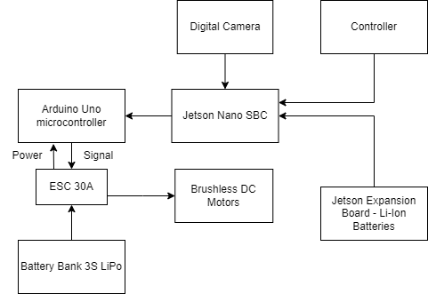
Components in the AUV
Figure 2: Block diagram of basic components

Slide 5
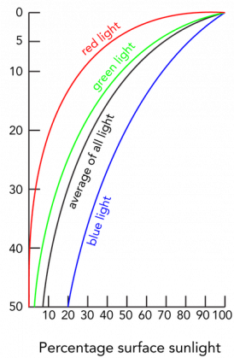
Vision Based Feedback
Cameras are part of AUV payloads
Uses depth information mostly, to build a map of underwater environment
Some challenges: Light attenuation, colour distortion, refraction
Solutions:
Stereo Vision
Image Processing techniques
Coupling with acoustic or ultrasonic sensors
Depth (m)
Figure 3: Light Attenuation
https://manoa.hawaii.edu/exploringourfluidearth/physical/ocean-depths/light-ocean
Notes:
A majority of ROVs/AUVs consider cameras as part of their payload - most applications require the usage of a visual camera. With the availability of a GPU on board, the motive is to use camera feed in aiding the navigation and control systems of the drone. A combination of underwater distance sensors and cornerpoint detection on camera feed can help in localization of the drone underwater. There are however a few challenges associated with vision based feedback, namely: light attenuation, color and shape distortion. Underwater images are low contrast and blurry because of all the scattering. As this figure shows, intensity of light drops down siginificantly quick as depth increases. A solution would be to process the camera feed or add a flashlight to increase visibility.

Slide 6
Localization of AUV
Localization refers to determining position and orientation of the drone underwater.
- Using Inertial Navigation Systems – Accelerometers and Gyroscopes
- Cameras and Feature Tracking
- Depth sensors, Ultrasonic sensors
- Doppler Velocity Log (DVL) for taking water currents into account
- Acoustic SLAM
Notes:
Localization of an AUV is the determination of the position and orientation of the drone underwater. This is difficult as GPS signals cannot penetrate water effectively, so localization from the surface or by using a satellite is not possible. For this, Inertial Navigational systems and such sensors come in handy. INS comprise of accelerometers and gyroscopes which can return linear acceleration values as well as the drone's rate of roll, pitch and yaw orientation. Recording these values over time and integrating can lead us to position information relative to the starting point. As mentioned earlier, camera input can also help in localization when coupled with ultrasonic sensors.Taking all these 3 ways into consideration, a drone can be localized with decent accuracy over short distances. If run times are larger however, with more environmental factors coming into play, Doppler Velocity Log (DVL) sensors can augment the INS readings to provide better results.

Slide 7
Navigation System of AUV
The A* Algorithm for underwater path planning:
Finds the shortest path between 2 points in space by minimizing a cost function
The search space is a 3D grid, each cell has a waypoint
Cells containing obstacles are marked as high-cost/non-traversable
Heuristic for the A* algorithm:
Euclidean distance in 3D or
Energy-based cost considering currents and depth.
Dead Reckoning using sensor input + camera feed for travelling to nearby cell
Grid can be built in real time, albeit with low resolution
Assumes still water – for reducing complexity
Notes:
The A* algorithm happens to be one of the most optimal and fast pathfinding algorithms. The main idea behind A* is that it minimizes the shortest path between two points in space by minimizing a cost function, which is really a sum of two terms, the movement cost and the heuristic function..

Slide 8

The PID Controller
The most common controller found in autonomous vehicles
Used in control systems to regulate processes such as the movement and stabilization of an underwater robot – handles the propulsion system and navigation
Proportional (P): This term determines how aggressively the system responds to the error
Integral (I): This term sums up past errors to eliminate steady-state errors
Derivative (D): This term reacts to the rate of change of the error
The overall control function is given by
Notes:
This is the most common type of controller found in autonomous vehicles. In this work the PID controller is used to control position of the drone and its propulsion systems. The generic form of the control equation is as shown, with Kp, Kd and Ki being the proportional, derivative and integration terms respectively. Very briefly, kp handles the aggression of the response, how quickly the system is to effect given input into desired steady state output. K_i term handles accumulation of steady state errors over time while the Kd term handles the rate of change of error.

Slide 9
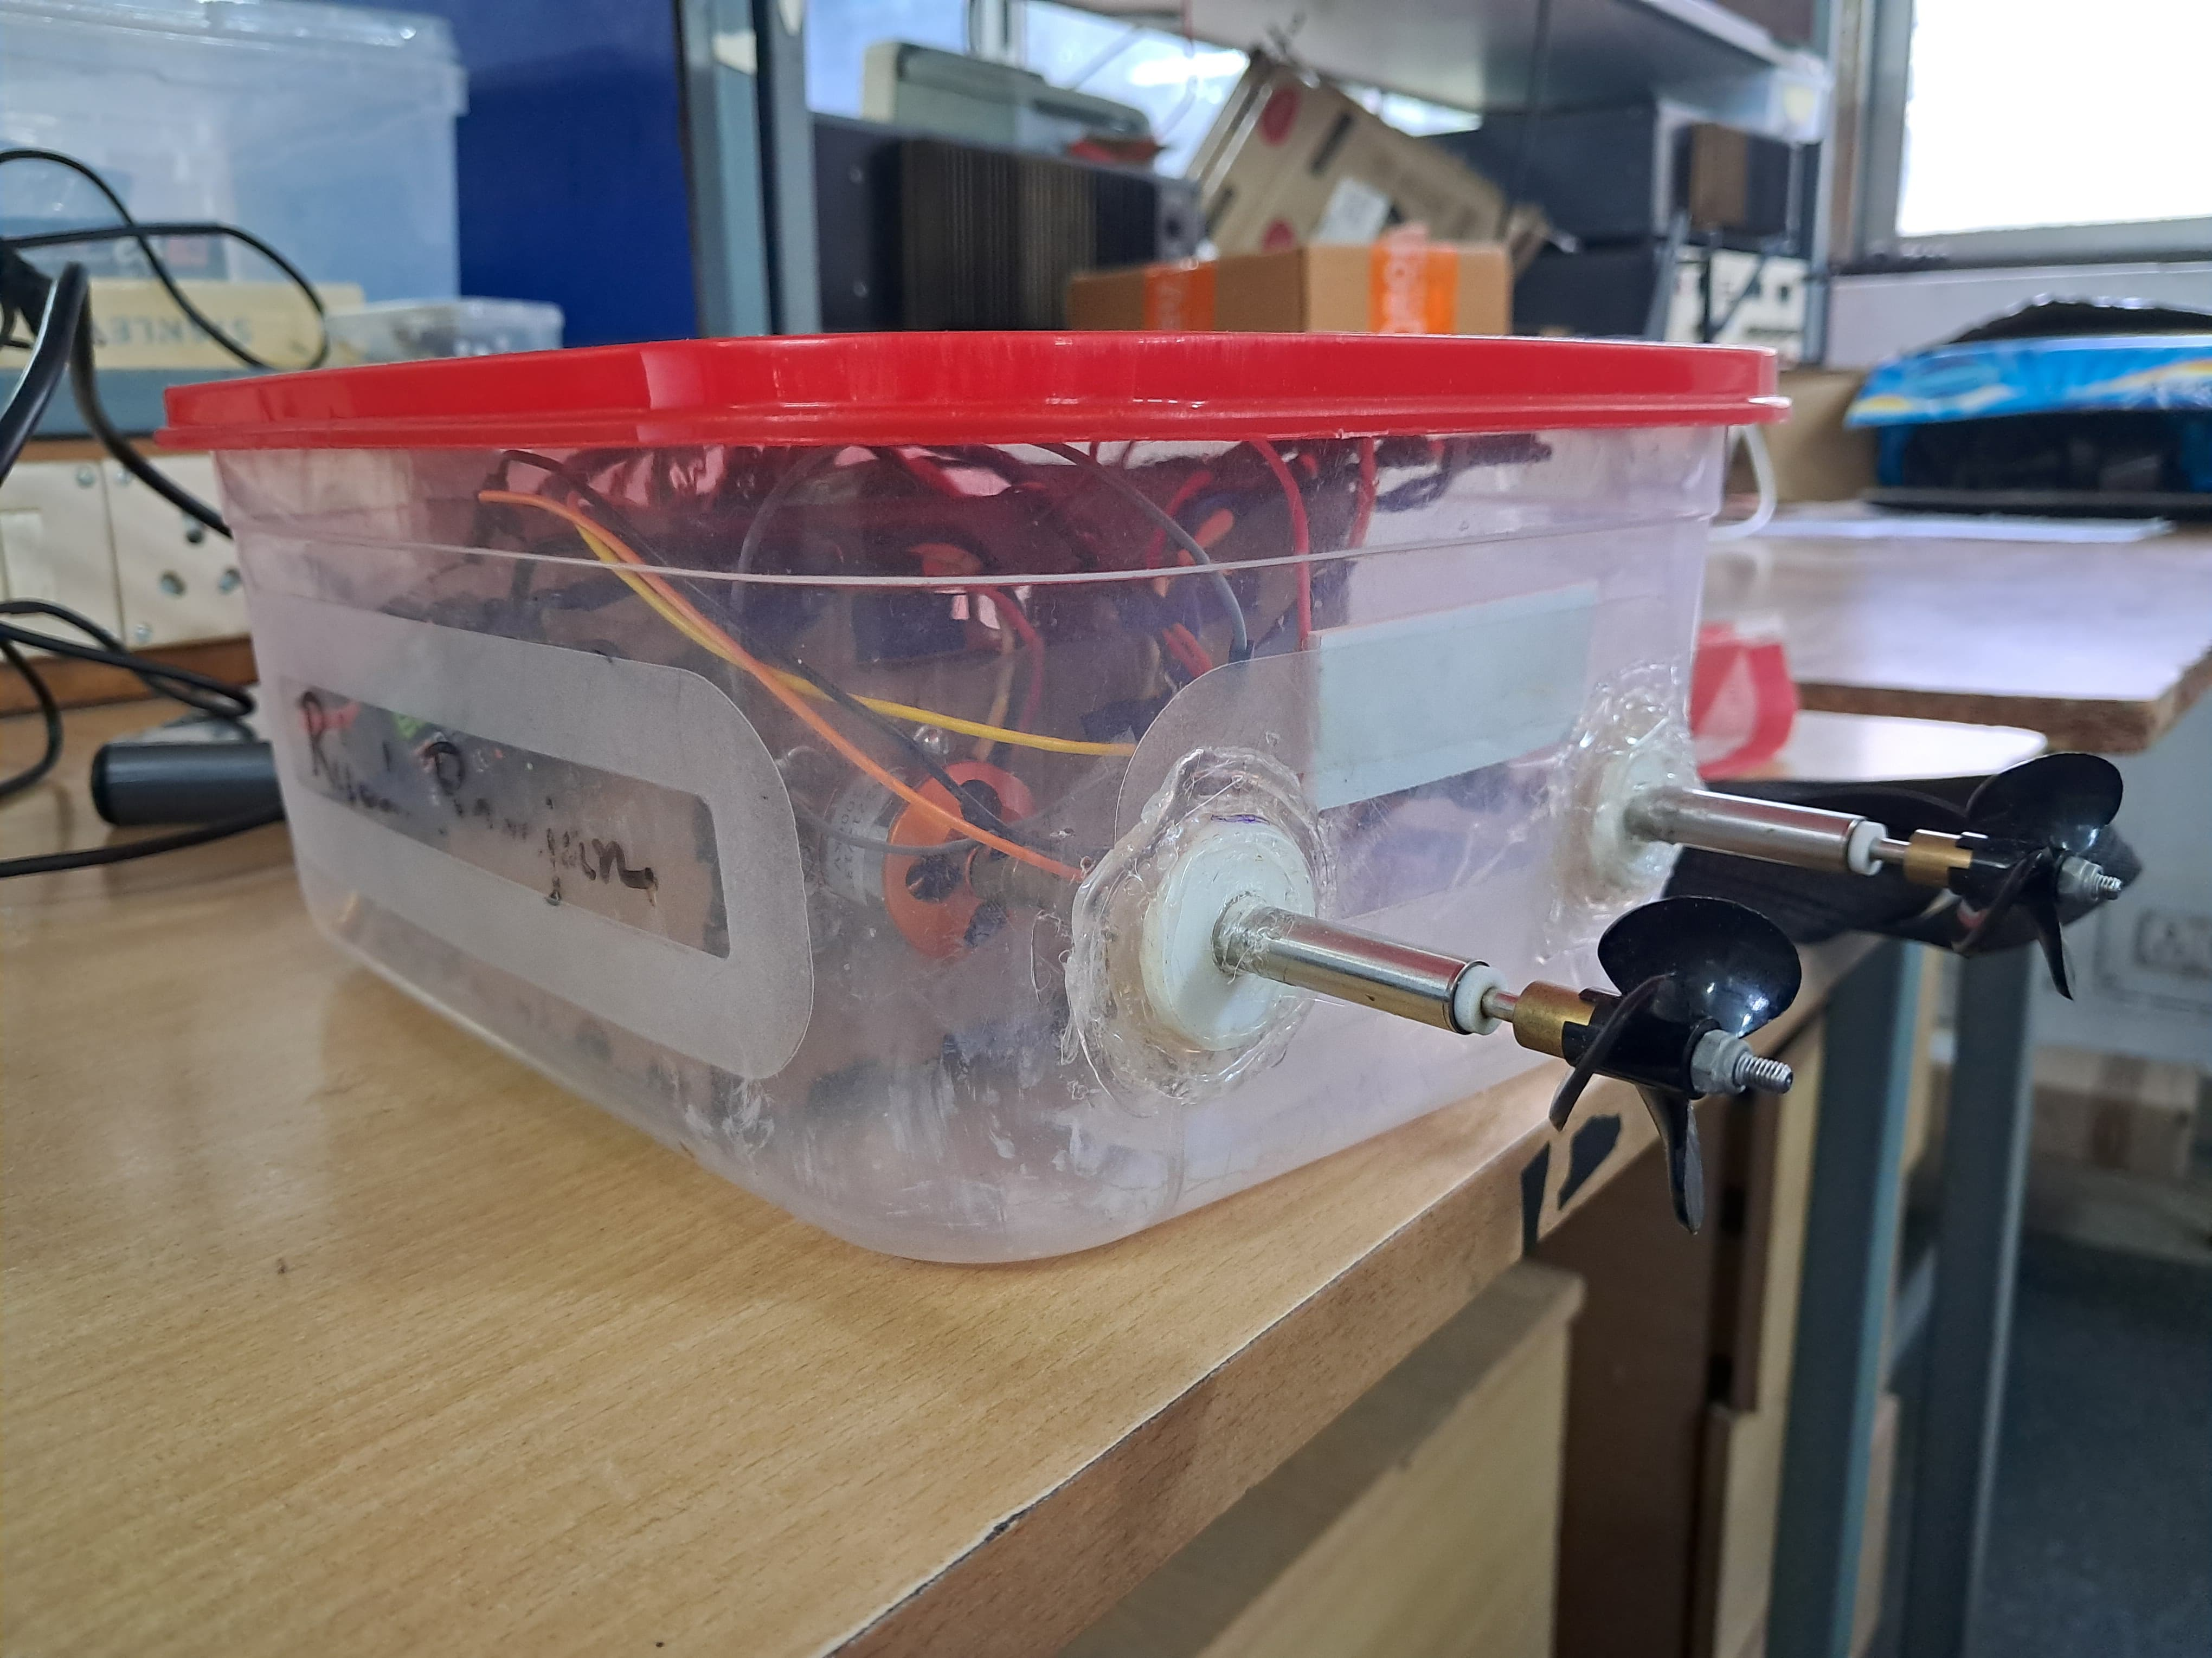
Work done so far
Unmanned Surface Vehicle
Supports a camera payload and records video footage/take photos underwater
Controlled by a human operator, via wireless BT controller
Telemetry via Wi-Fi – can report back metrics
Integrating A* algorithm
Figure 4: Current version of the drone

Slide 10
Challenges
Short testing durations
Larger the battery pack, greater weight – greater thrust needed
Vision + Navigation algorithms – higher power drawn
Accumulation of sensor errors over time
Low-cost solutions typically perform worse over larger distances/times
Limited compute ability on SBC
Weight Balancing
Lopsided weight distribution in the drone can add to sensor errors

Slide 11
References
1. Marthiniussen R., Vestgard K., Klepaker, R. A. and Storkersen N., "HUGIN-AUV concept and operational experiences to date," Oceans '04 MTS/IEEE Techno-Ocean '04 (IEEE Cat. No.04CH37600), Kobe, Japan, 2004, pp. 846-850 Vol.2
2. Sun F., Yu J. and Xu D., "Visual measurement and control for underwater robots: A survey," 2013 25th Chinese Control and Decision Conference (CCDC), Guiyang, China, pp. 333-338, 2013
3. Shen C., Shi Y. and Buckham B., “Trajectory Tracking Control of an Autonomous Underwater Vehicle Using Lyapunov-Based Model Predictive Control,” in IEEE Transactions on Industrial Electronics, vol. 65, no. 7, pp. 5796-5805, 2018
4. Li, D., Wang, P. & Du, L., “Path Planning Technologies for Autonomous Underwater Vehicles-A Review”, IEEE Access, PP. 1-1, 2018

Slide 12
Thanks!
Q&A Time

